Slide 1
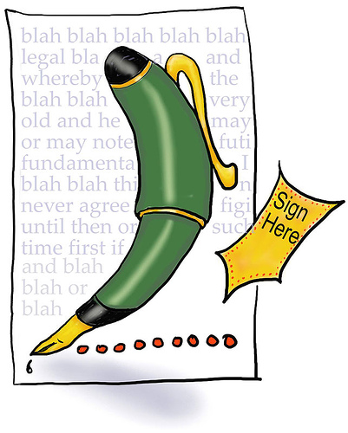
Writing a formal letter

Slide 2
Planning - Always spend a few minutes planning what you will say and to whom – get your audience right!
Ordering - Organise the order in which you present and structure your ideas
Layout (on slide below) - Ensure you use the correct layout for a formal letter
Start using the standard layout and include your reason for writing the letter in the first paragraph. (see suggested openings and closings sheet)
I wish to express my concern regarding...
I feel compelled to respond/write/reply to _____ with regard to...
Write up the ideas from your plan, creating a detailed paragraph for each one with convincing and realistic points/ideas/opinions.
Keep writing formal and polite
Write in paragraphs – one for each idea
Write a final paragraph thanking the reader for considering your ideas and
summing up your reasons for writing.
Dear (name) = yours sincerely
Dear Sir/Madam = yours faithfully
7. Proofreading - Spend a few minutes reading and checking through your letter.

Slide 3
1 Green Lane
Euxton
Chorley
Lancashire
PR7 9NH
17th January 2014
Mr T Holmes
The Editor
The Times
London
LW1 3TY
Dear Mr Holmes/ Sir/Madam
Re: (subject matter)
Introduction to reason for writing
Two or three paragraphs discussing the topic
Conclusion – summarising/thanking and asking for a response/reply
Yours sincerely /faithfully,
Mr I Comment

Slide 4
Suggested Openings
Dear sir/madam,
I wish to express my concern regarding
Following the recent article, published/featured in……., I would like to propose/argue/express/put forward my view
As a concerned teenager/student/citizen ……I feel very strongly about the issue of …….. and wish to argue/advise
I feel compelled to respond/write/reply to ……../with regard to
It has come to my attention that...
Having recently read/heard/been advised that…….I wish to …./I would like to take this opportunity to ……….
In response to the recent article/newsletter/information regarding, I would like to/I wish to/
I feel that following the recent………, it is in my best interest to respond/reply/ express my opinion on…..

Slide 5
Suggested Endings
Finally, I would like to take this opportunity to thank you….
Please do not hesitate to contact me if there are any further question/queries about this matter/ my proposals
I look forward to your prompt reply
I look forward to hearing from you soon
I would welcome the opportunity to discuss this matter further and look forward to your response
Many thanks for considering my views
Finally, I trust that these proposals have met with your approval and look forward to hearing from you soon.
Finally, I hope other readers will agree with me that ……….
Finally, I am sure that other readers/citizens/students etc. will agree with me when I say…../will agree with my view/proposals/ideas
Sign and print name (initial and surname)

Slide 6
Top Tips for Excellent Letters
1.) Use imperatives (command)
Imagine my horror when...
Picture the scene:
Consider
Discover
Think about
2.) Use rhetorical questions (remember to end the sentence with ?)
How would you feel if....?
What would...?
Why....?
3.) Use adverbial phrases
Arguably,
Clearly,
Sadly,
Horrifically,
Shockingly,
Ultimately,
Mainly,
Questionably,
Ironically,
Obviously
4.) Use connectives
Moreover,
Also,
Furthermore,
Additionally,
In addition,
Surely,
Ultimately,
To conclude,
In particular,
Without doubt,
5.) Use persuasive features FOREST DRIP

Slide 7
A FOREST DRIP
Anecdotes – remember the lady from London who swallowed a fly and everyone thought she would die?
Facts/statistics – over 96% of dog owners said…
Opinions – the best way to lose weight is to cut out fatty foods
Rhetorical question – don’t we all want to do well at school?
Emotive language/exaggeration – the tragic loss of pies from the school lunch menu….
Sarcasm or humour – you do know that training for a marathon does not include a daily jog to Macdonald’s?
Triples – annoyed, appalled and irritated
Direct language/inclusive language – you, we, our, us
Repetition – education, education, education
Imperatives – try this, consider…picture, imagine, follow, look, stop,
Punctuation for effect - ! ? : ; -

