Slide 1
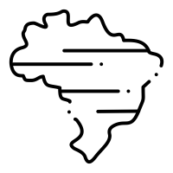
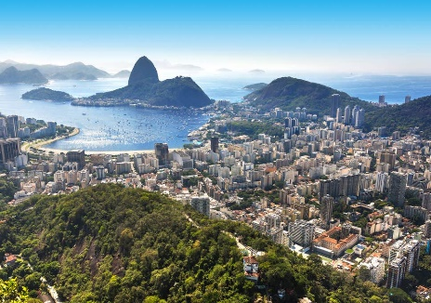
Rio
Location
Rio de Janeiro is located on the east coast of Brazil, in the continent of South America
Rio is south of the Amazon Rainforest
Poverty in Rio
What are favelas? (also known as slums)
Where are they built in Rio?
Watch this video. Create a table (or spider diagram) of the good things happening in favelas and the bad things https://www.youtube.com/watch?v=c3BRTlHFpBU
Write a paragraph explaining why you would, or would not like to visit the Rio favelas (Try and be as specific to Rio as possible – Eg facts and figures!)
Interesting Fact
Rio is not the capital city of Brazil. It is actually Brasilia

Slide 2
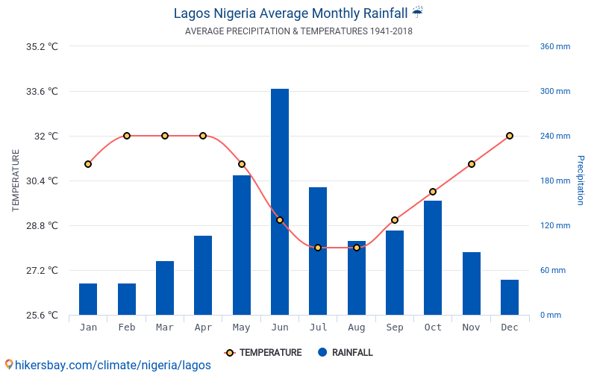
Lagos
Location
Lagos is located in the South of Nigeria, in the continent of Africa
Lagos is very close to the equator so gets very warm and wet
Click to hear an explanation on what climate graphs show.
Climate
What is the lowest temperature?
What month(s) is that in?
What is the highest temperature?
What month(s) is that in?
What is the lowest rainfall?
What month(s) is that in?
What is the highest rainfall?
What month(s) is that in?
What is the range (highest minus the lowest) in temperature and rainfall?
Write a paragraph explaining which month someone should visit, why and what they should pack
Interesting Fact
Lagos Is The Only African City In The List Of “The World’s 10 Most Populated Cities”

Slide 3
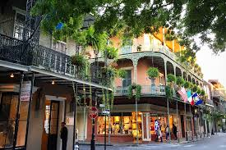
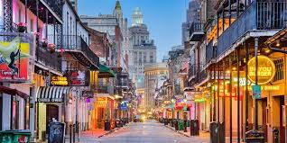
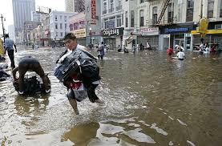
New Orleans
Location
New Orleans is located in the South of the Untied States of America, in the state of Louisiana.
It’s location means it is has lots of hurricanes
Hurricane Katrina, 2005
Watch the video and create a timeline of events - including facts and figures and effects you can see from the video. (American dates are backwards to ours – so 8/29th is the 29th of August) https://www.youtube.com/watch?v=HbJaMWw4-2Q
Create a table (or spider diagram) with 3 headings – Environmental effects, social effects and economic effects. Research 3 effects for each category about how the city was affected by Hurricane Katrina, 200
Interesting Fact
In 1796, New Orleans became the first city to host Opera in the United States.
Environmental effects (How the environment was affected) | Social effects (How people were affected) | Economic effects (Effects on money/ the cost of the damage)
Websites that are
helpful
http://www.hurricanescience.org/history/studies/katrinacase/impacts/

Slide 4
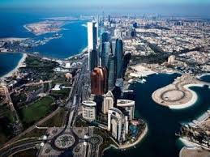
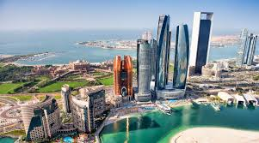
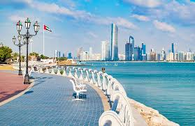
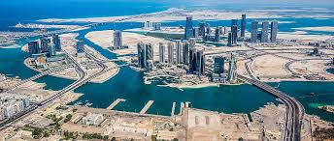
Abu Dhabi
Location
Abu Dhabi is the capital city of the United Arab Emirates (UAE) in the continent of Asia
It is on an island off the Persian Gulf, off the central west coast.
Oil economy
How much oil does Abu Dhabi have?
How much money does this make them?
What did the government have to do to make the town into a city? (e.g build roads) (Create a timeline if you want to)
Tourism economy
When did tourism start in Abu Dhabi?
Why do you think its important to get tourists in (as well as selling lots of oil?)
How long would it take from Manchester?
Use the link for Google Earth, why do you think lots of people visit every year?
https://earth.google.com/web/@24.4917268,54.3525789,2.61124a,0d,59.99999999y,105.79225018h,93.65892076t,0r/data=IjAKLEFGMVFpcFBlSGs2NU1WMW95VWZsSzZVck9XenFpTzltVC1faEd4NElvRWFyEAU
Explain 3 things people can do/ visit when they get here.
Interesting Fact
Abu Dhabi accounts for about two-thirds of the roughly $400 billion UAE economy but only really started growing in the 1960s!
Websites that are
helpful
https://www.britannica.com/place/Abu-Dhabi

